Slide 1

Uniconic
Because Unicorns deserve better metrics.
Group 16: Haiduti Code
Prepared by: Danail Ignatovski, Mark David Lejko, Petar Malamov, Utkarsh Sawant, Gunay Ismayilzada
24.04.25

Slide 2

Agenda
Business Opportunity for digital data analyzer
How Uniconic works
Our UVP and unfair advantages

Slide 3

Business Opportunity for
Uniconic
Lots of paperwork in existing venture capital evaluations
Existing platforms lack transparency
Significant customer-friendly features are missed

Slide 4
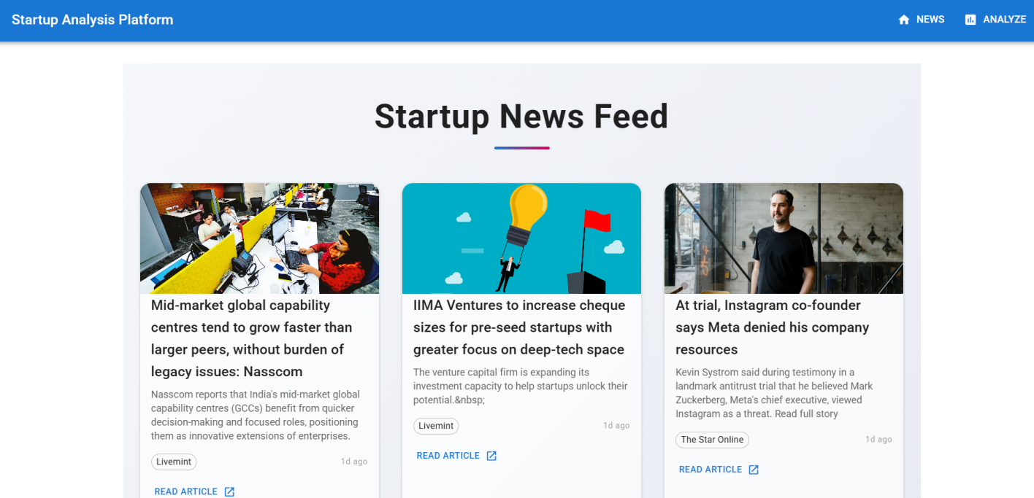
How Uniconic works
MVP

Slide 5
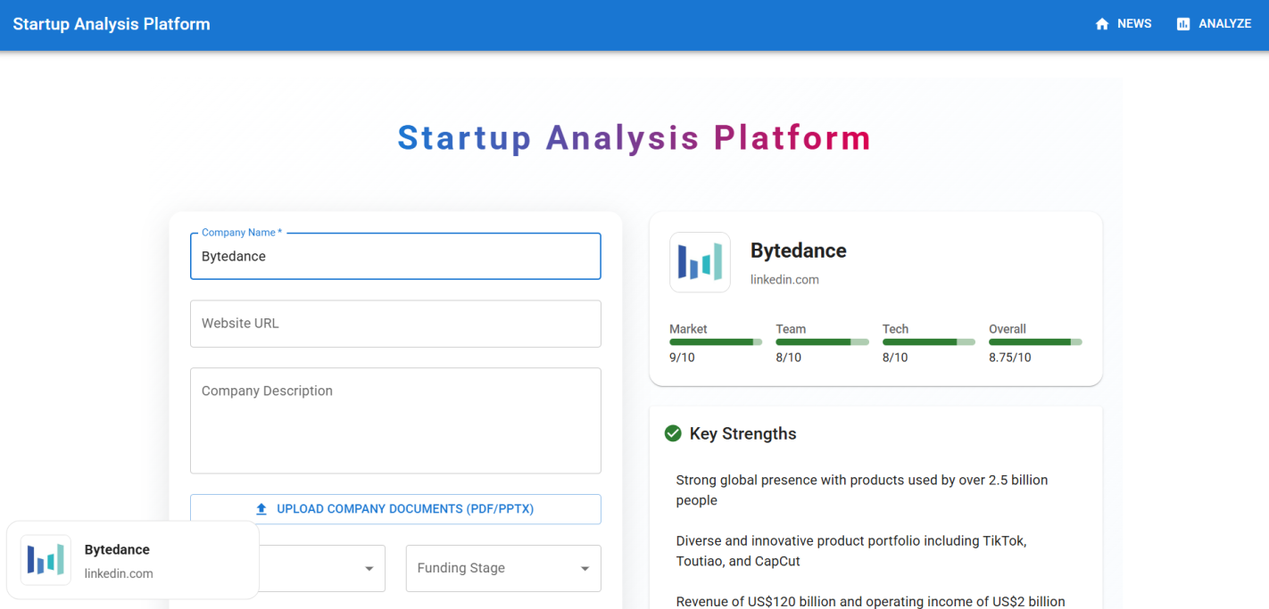
How Uniconic works
MVP

Slide 6
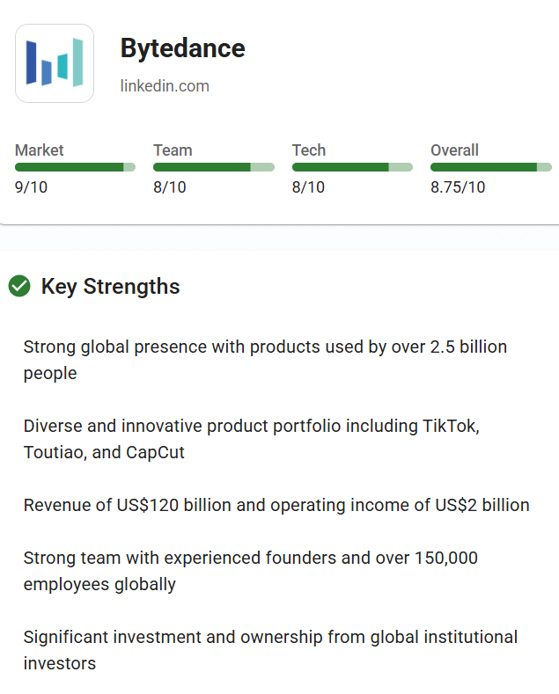
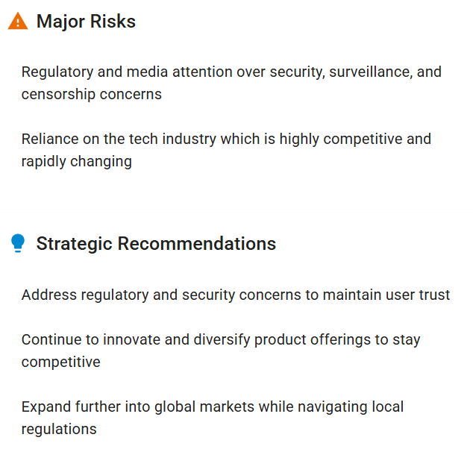
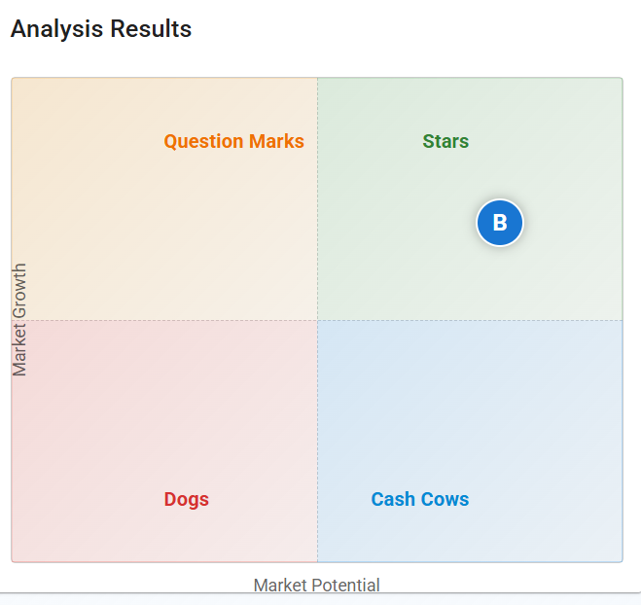
How Uniconic works
MVP

Slide 7

UVP and unfair advantages
Green Flags
Focus on Founding team
Transparency with justified interpretation
Adaptability
Uploading pitch deck or video

Slide 8
Future milestones
Launch Ai-driven startup scoring engine
Add & analyze historic unicorns (pdf upload)
Investor pitch generator
VC & accelerator platform integration
Subscription monetization + predictive API

Slide 9


In short, Uniconic Makes Sense
Because Unicorns deserve better metrics.

Slide 10
References
CB Insights. (n.d.). The complete list of unicorn companies. CB Insights. Retrieved from https://www.cbinsights.com/research-unicorn-companies
Logo made
Demo video

